Slide 1
The Effect of Spatial Proximity on R&D and Innovation: Evidence from British Advanced Manufacturing
Emil Evenhuis
In collaboration with Richard Harris and John Moffat
as well as Peter Sunley, Ron Martin, Andy Pike (and Jack Harris)
5th Geography of Innovation conference, Stavanger, 29-31 January 2020
Session “Proximity and Innovation I”

Slide 2
Team
Dr Emil Evenhuis
PBL- Netherlands Environmental Assessment Agency; and School of Geography and Environmental Science, University of Southampton
emil.evenhuis@pbl.nl
Prof Peter Sunley
School of Geography and Environmental Science, University of Southampton
p.j.sunley@soton.ac.uk
Prof Richard Harris
Business School, Durham University
r.i.d.harris@durham.ac.uk
Prof Ron Martin
Department of Geography, University of Cambridge
rlm1@cam.ac.uk
Dr John Moffat
Business School, Durham University
john.moffat@durham.ac.uk
Prof Andy Pike
Centre for Urban and Regional Development Studies, Newcastle University
andy.pike@newcastle.ac.uk
Dr Jack Harris
School of Geography and Environmental Science, University of Southampton
j.l.harris@soton.ac.uk
Notes:
Provisional early results – nothing too profound but starting to show a pattern of dispersal and important differences with regional categories

Slide 3
Outline
UK policy context and research project
The changing geography of advanced manufacturing in Britain
What is the effect of spatial proximity on R&D and innovation performance?
Conclusions
Notes:
Provisional early results – nothing too profound but starting to show a pattern of dispersal and important differences with regional categories

Slide 4
UK policy context
and research project

Slide 5
Policy context
UK governments have since 2008 repeatedly expressed political concern to ‘rebalance’ economy, both sectorally and spatially.
Publication of the UK ‘Industrial Strategy’ in 2017, with core focus on ‘advanced manufacturing’, and with a renewed emphasis on ‘clusters’.
Is rebalancing possible through (place-specific and place-based) support of advanced manufacturing, and if so how exactly?
Parts of advanced manufacturing in which UK has strengths and potential comparative advantage
Cluster potential and benefits, opportunities for ‘reshoring’, servitisation, ‘Industry 4.0’, attraction of FDI?
So far little analysis of industry that policy is seeking to target

Slide 6
Large challenges
Profound deindustrialisation since the late 1960s
Eroded supply chains, skills shortages, gaps and breaks in innovation and production systems, and isolation of manufacturing SMEs
Impacts of ‘Industry 4.0’ and servitisation unknown
Big differences in productivity and innovation performance across different industries, between different regions, and between different firms
Brexit costs and uncertainties

Slide 7
“Manufacturing Renaissance in Industrial Regions?”-project
Overall objective – investigate the evolution of advanced manufacturing across Britain, to develop better and more complete evidence-base for policy.
What’s the potential for sectoral and spatial re-balancing?
Understand differential performance of advanced manufacturing industries across Britain.
Role of clustering, horizontal and cross-sectoral agglomeration economies, and localised/regionalised ‘ecosystems’?
What does this mean for creating a context in which advanced manufacturing can flourish? – In particular for Traditional Industrial Regions.
www.manufacturing-regions.org.uk

Slide 8
Research Design and Data
Aggregate level data on GVA and employment from Cambridge Econometrics:
NUTS2-level for a number of sectors for 1971-2015 (SIC 2007)
LAD-level data with more detailed sectoral breakdown for 1991-2015 (SIC 2007)
Micro-data sources:
Annual Respondents Database manufacturing firms 1973-2016 (SIC 1980)
Community Innovation Surveys (CIS4 to CIS10) 2004-2016 (SIC 1992)
Interviews and focus groups, in combination with firm survey in 3 regions (East Midlands, North West and Scotland Central Belt), covering 4 industries (aerospace, pharmaceuticals, electronics, and motor vehicles).

Slide 9
The changing geography of
advanced manufacturing in Britain

Slide 10
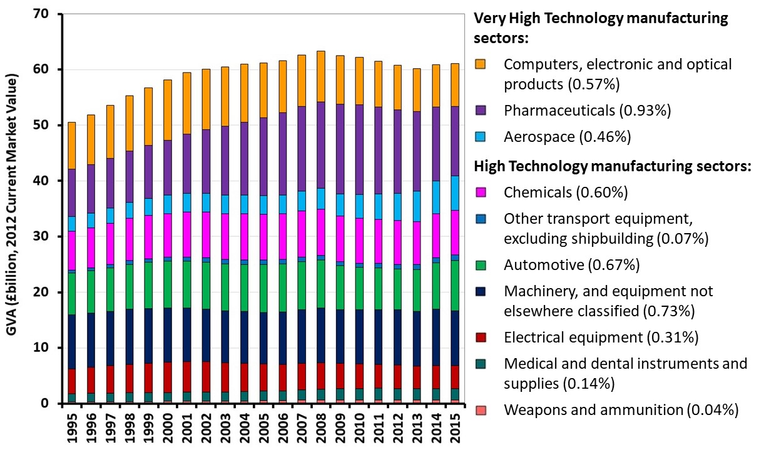
Advanced Manufacturing industries
Cambridge Econometrics, series at LAD-level 1991-2015, based on rolling 5-year averages

Slide 11
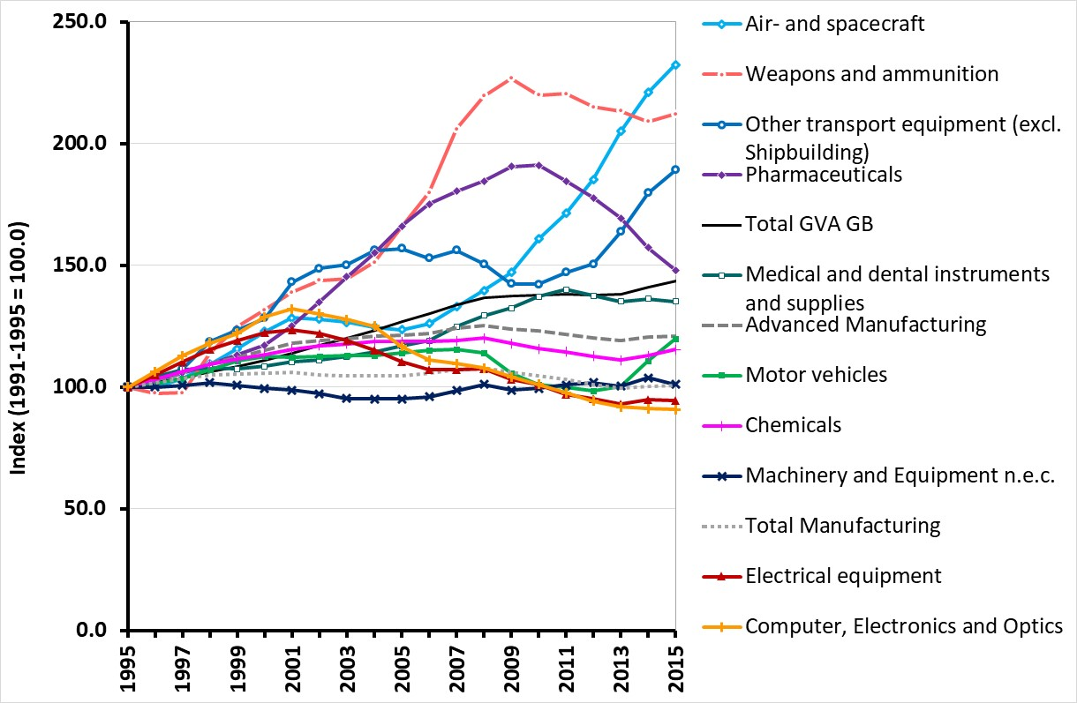
Development of output in different Advanced Manufacturing industries in Britain 1991-2015
Cambridge Econometrics, series at LAD-level 1991-2015, based on rolling 5-year averages

Slide 12
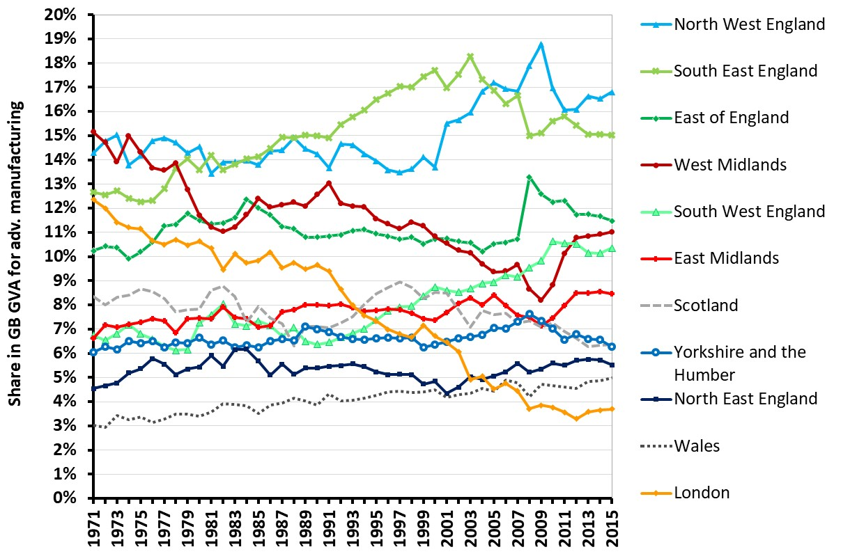
Regional Shares of Advanced Manufacturing GVA
Cambridge Econometrics, series at NUTS2-level 1971-2015

Slide 13
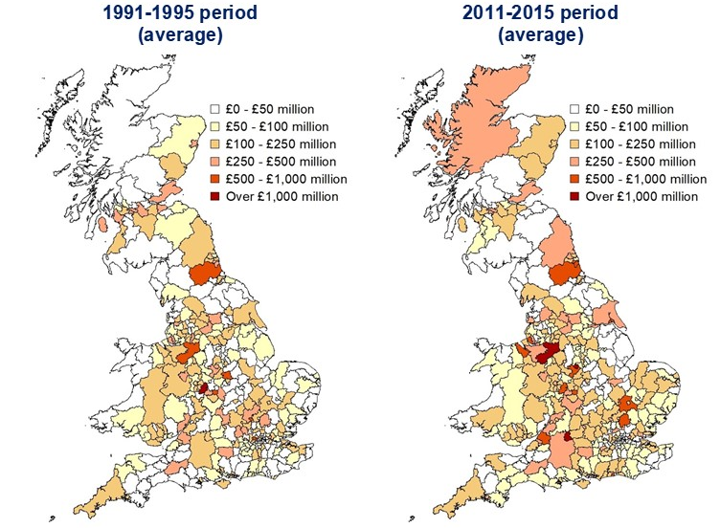
Development of GVA in total AM across Local Authority Districts in Britain
Cambridge Econometrics, series at LAD-level 1991-2015, based on 5-year averages

Slide 14
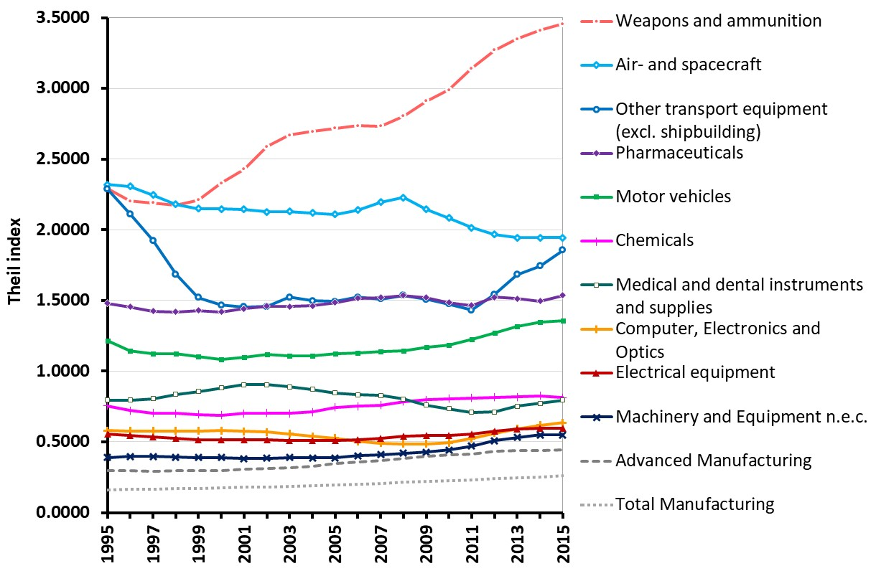
Development of Theil index for AM industries based on shares in GVA of LADs
$$T_{i}=\sum_{r=1}^{R}{\frac{{GVA}_{ri}}{{GVA}_{i}}\ln\left(\frac{{{GVA}_{ri}}/{{GVA}_{i}}}{{{GVA}_{r}}/{GVA}}\right)⁡}$$
Cambridge Econometrics, series at LAD-level 1991-2015, based on rolling 5-year averages

Slide 15
Differences between AM sectors and performance in Traditional Industrial Regions
 | Concentrated sector | Dispersed sector
Relatively stronger performance in (some) TIRs | Aerospace Motor vehicles Other transport equipment (excl. aerospace) | Chemicals Machinery and equipment n.e.c. Medical and dental instruments and supplies
Relatively weaker performance in TIRs | Pharmaceuticals Weapons and ammunition | Computers, Electronics and Optics Electrical equipment

Slide 16
Questions in context of cluster-based policies aimed at spatial and sectoral rebalancing
With regard to trends over time | No evidence of a trend towards more concentration across the various industries. Is this an issue for innovation / R&D performance?
With regard to differences between industries | Only some AM industries relatively concentrated (in particular Aerospace, Motor vehicles, Pharmaceuticals). Other AM industries more dispersed. Is this an issue?
With regard to differences between regions | Is it the case that the industries that do well in (some) TIRs have a more ‘synthetic’ knowledge-base (predicated on engineering-based know-how)? While industries with a more ‘analytic’ knowledge base (hence relying on R&D activities and science-based innovations) prefer other regions?

Slide 17
Effect of spatial proximity
on innovation and R&D
The work in this section contains statistical data from the ONS which is Crown copyright and reproduced with the permission of the controller of HMSO and Queen’s printer for Scotland. The use of the ONS statistical data in this work does not imply the endorsement of the ONS in relation to the interpretation or analysis of the statistical data. This work uses research datasets which may not exactly reproduce National Statistics aggregates.

Slide 18
Basis for model: Spatial proximity and R&D / innovation in plants
Knowledge spillovers
Mobility of workers
Plants in same industry in vicinity
Internal absorptive capacity of plant
R&D activity / Innovation in plant
Plants in related industries in vicinity
Selection effect
Various other sources of knowledge:
Universities / research institutes
Long distance connections / ‘Global pipelines’
…
Other variables with regard to plant / firm, and context in which it operates:
Size of plant
Education level employees
Capital intensity
Age of plant
Ownership
Size and type of firm
Undertaking FDI
Industry structure
Urbanisation externalities

Slide 19
Data, Dependent variables and Type of analysis
Panel dataset (2004-2016), in which multiple datasets are merged (at Reporting Unit level):
Community Innovation Survey data 2004-2016 (CIS4 to CIS10).
Annual Respondents Database / Annual Business Survey 1984-2016
Annual Inquiry unto Foreign Direct Investment 1996-2016.
Dependent variables:
R&D: dummy indicating R&D taking place.
Innovation: dummy indicating product or process innovation.
Type of analysis:
Random effects probit regression.

Slide 20
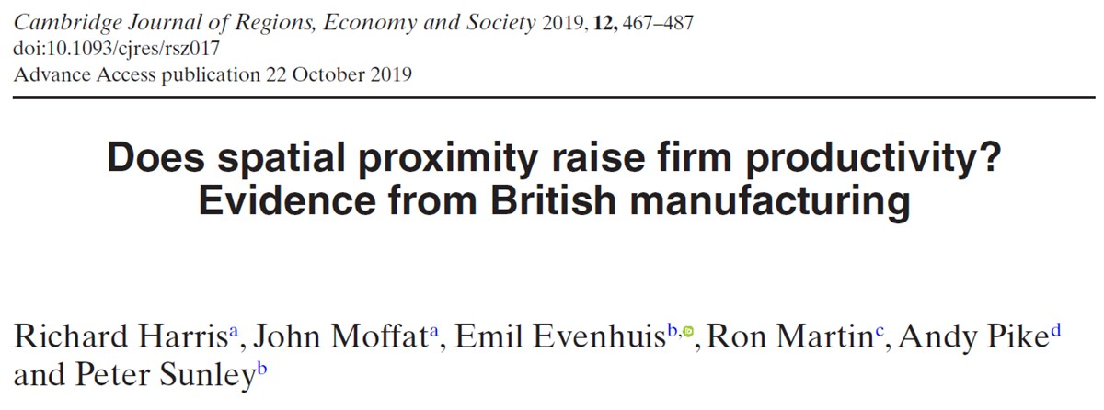
Constructing a Distance Index to operationalise Spatial Proximity (1)
Following Scholl and Brenner (2016) calculated a Distance Index for each plant, as a measure for spatial concentration:
$$D_{i}=\frac{1}{J−1}\sum_{j=1,j≠i}^{J}{\frac{E_{j}}{\sum_{k=1,k≠i}{E_{k}}}e^{−x(d_{i,j})}}$$
Where $D_{i}$ is the sum of inverted distances from plant $i$ to all other plants in the same 4-digit industry; $J$ is the number of observations; $E_{j}$ is employment in plant $j$, $\sum_{k=1,k≠i}{E_{k}}$ is the sum of employment in all plants in an industry except plant $i$; $d_{i,j}$ is the distance between plant $i$ and plant $j$, measured in kilometres.
$x$ is the distance decay factor; set to 0.05 (but other options would be possible for sensitivity analysis, e.g. 0.01 or 0.10).

Slide 21
Constructing a Distance Index to operationalise Spatial Proximity (2)
In a hypothetical industry of three plants, each of which has different employment levels, the values of spatial concentration are:
$D_{1}=0.04$7
$D_{2}=0.097$
$D_{3}=0.065$
Plant 1
50 km
40 km
Plant 3
Plant 2
30 km

Slide 22
Constructing an Absorptive Capacity index (1)
Harris & Yan (2018), p. 734, Table 2 (https://doi.org/10.1111/joes.12296)

Slide 23
Constructing an Absorptive Capacity index (2)
Harris & Yan (2018), p. 734, Table 2 (https://doi.org/10.1111/joes.12296)

Slide 24
Constructing an Absorptive Capacity index (3)
Covers two dimensions:
Internal capacity to navigate and process external knowledge.
Existence of external links to sources of knowledge.
May serve as proxy for cognitive, organizational, social and institutional proximities (Boschma, 2005).
Also look at plants nearby in ‘related industries’? (i.e. bring in combination of spatial and cognitive proximity more explicitly)?

Slide 25
‘Heterogeneous agglomeration’?
Differences in importance of spatial proximity (and other proximities) between types of industries or between different stages of the industry? (e.g. Faggio et al., 2017; Nakamura, 1985)
Spatial proximity to other plants in same industry, more important in industries characterised by mostly synthetic knowledge base? (e.g. aerospace, automotive) (e.g. Asheim et al., 2011)

Slide 26
Full results for all Advanced Manufacturing sectors (Weighted) marginal effects of changes in variables on probability that RU undertook R&D/Innovated, 2004-2016 (based on random effects probit model)
 | R&D |  | Innovation
N obs | 4,962 |  | 4,962
N Reporting Units | 2,823 |  | 2,823
 | dy/dx | z-value | dy/dx | z-value
ln distanceª | 0.015 | 3.11 | -0.003 | -0.60
Absorptive capacityª | 0.423 | 142.94 | 0.446 | 152.01
ln distance^{b} | 0.018 | 3.41 | -0.003 | -0.63
Absorptive capacity^{b} | 0.427 | 109.04 | 0.446 | 88.21
Absorptive capacity × ln distance^{b} | 0.006 | 1.12 | -0.001 | -0.11
ln employment | 0.026 | 7.31 | 0.028 | 7.62
ln wowemp | -0.015 | -5.53 | -0.008 | -2.84
Graduates
1-5% | 0.163 | 21.59 | 0.155 | 20.41
6-20% | 0.195 | 30.12 | 0.140 | 21.65
21-50% | 0.284 | 34.49 | 0.211 | 25.51
51+% | 0.275 | 25.81 | 0.144 | 13.54
ln lkl | -0.005 | -4.24 | -0.001 | -1.02
ln age | 0.000 | 0.11 | -0.010 | -3.01
Multireg | -0.004 | -0.50 | -0.059 | -7.37
Multisic | -0.020 | -2.17 | 0.051 | 5.22
Single | -0.029 | -3.21 | -0.005 | -0.50
 | R&D |  | Innovation
 | z-value | dy/dx | z-value | dy/dx
USA | -0.019 | -2.07 | 0.000 | -0.01
EU | -0.049 | -5.20 | -0.055 | -5.56
Other foreign-owned | 0.008 | 0.67 | 0.047 | 3.65
Outward FDI | 0.000 | -0.05 | 0.023 | 2.79
ln herf | -0.022 | -6.23 | -0.007 | -1.82
ln diversification | 0.001 | 0.12 | -0.019 | -3.89
London | -0.010 | -0.71 | 0.016 | 1.06
North East | 0.029 | 2.05 | -0.050 | -3.48
North West | 0.006 | 0.61 | 0.023 | 2.27
Scotland | -0.062 | -4.82 | -0.120 | -9.23
South East | 0.047 | 5.03 | 0.015 | 1.51
South West | 0.040 | 3.74 | 0.049 | 4.32
Wales | 0.043 | 3.20 | -0.026 | -1.89
West Midlands | 0.009 | 0.86 | 0.021 | 2.05
Yorks-Humberside | -0.028 | -2.70 | -0.046 | -4.18
Main city | -0.005 | -0.54 | 0.002 | 0.23
2006 | -0.008 | -1.21 | -0.044 | -6.25
2008 | 0.015 | 2.02 | 0.007 | 0.85
2010 | -0.016 | -2.05 | 0.032 | 3.81
2012 | -0.055 | -7.46 | -0.023 | -2.95
2014 | -0.107 | -13.40 | 0.031 | 3.86
2016 | -0.065 | -8.26 | 0.038 | 4.63
Pharmaceuticals | 0.007 | 0.43 | -0.013 | -0.82
Office machines | -0.007 | -0.57 | -0.037 | -2.73
Electrical | -0.041 | -5.62 | -0.049 | -6.36
Telecom equipment | -0.007 | -0.80 | 0.000 | -0.02
Instruments | -0.028 | -3.62 | -0.022 | -2.76
Motors | -0.077 | -8.67 | -0.099 | -10.53
Aircraft | -0.078 | -5.83 | -0.183 | -13.53
ª Increase in probability of R&D/innovation when absorptive capacity/ln distance changes from median to 99 percentile values (other margins in the table are either a unit change in the variable – continuous variables – or a change in the dummy variable from 0 to 1)
^{b} The second set of results of the impact of absorptive capacity/ln distance treat their effects as independent and a third term involving the interaction between the two variables in included

Slide 27
Results for individual sectors (1) (Weighted) marginal effects of changes in variables on probability that RU undertook R&D/Innovated, 2004-2016 (based on random effects probit models)
Motor vehicles
 | R&D |  | Innovation
N obs | 1,112 |  | 1,112
N Reporting Units | 623 |  | 623
 | dy/dx | z-value | dy/dx | z-value
ln distance | -0.021 | -1.58 | -0.047 | -3.55
Absorptive capacity | 0.505 | 69.50 | 0.531 | 66.96
ln distance^{b} | -0.025 | -1.81 | -0.052 | -3.98
Absorptive capacity^{b} | 0.494 | 27.97 | 0.498 | 17.22
Absorptive capacity × ln distance^{b} | -0.011 | -0.89 | -0.021 | -1.70
Pharmaceuticals
 | R&D |  | Innovation
N obs | 166 |  | 166
N Reporting Units | 67 |  | 67
 | dy/dx | z-value | dy/dx | z-value
ln distance | -0.109 | -1.71 | 0.050 | 1.38
Absorptive capacity | 0.296 | 17.64 | 0.394 | 22.46
ln distance^{b} | -0.101 | -2.21 | 0.069 | 1.76
Absorptive capacity^{b} | -0.239 | -1.19 | 0.443 | 13.13
Absorptive capacity × ln distance^{b} | -0.067 | -8.30 | 0.041 | 2.05
Aircraft
 | R&D |  | Innovation
N obs | 333 |  | 333
N Reporting Units | 175 |  | 175
 | dy/dx | z-value | dy/dx | z-value
ln distance | -0.132 | -3.29 | 0.019 | 0.48
Absorptive capacity | 0.456 | 20.90 | 0.509 | 15.51
ln distance^{b} | -0.136 | -4.47 | 0.013 | 0.34
Absorptive capacity^{b} | -0.106 | -0.65 | 0.251 | 0.93
Absorptive capacity × ln distance^{b} | -0.113 | -7.87 | -0.040 | -0.92
Chemicals
 | R&D |  | Innovation
N obs | 687 |  | 687
N Reporting Units | 404 |  | 404
 | dy/dx | z-value | dy/dx | z-value
ln distance | 0.077 | 7.51 | 0.047 | 3.98
Absorptive capacity | 0.359 | 50.70 | 0.385 | 60.16
ln distance^{b} | 0.105 | 10.62 | 0.052 | 4.50
Absorptive capacity^{b} | 0.390 | 52.68 | 0.396 | 42.78
Absorptive capacity × ln distance^{b} | 0.046 | 8.64 | 0.013 | 1.36

Slide 28
Results for individual sectors (2) (Weighted) marginal effects of changes in variables on probability that RU undertook R&D/Innovated, 2004-2016 (based on random effects probit models)
Computers (office machinery)
 | R&D |  | Innovation
N obs | 151 |  | 151
N Reporting Units | 111 |  | 111
 | dy/dx | z-value | dy/dx | z-value
ln distance | 0.091 | 0.60 | -0.227 | -8.63
Absorptive capacity | 0.356 | 2.83 | 0.372 | 19.54
ln distance^{b} | 0.128 | 8.67 | -0.231 | -8.95
Absorptive capacity^{b} | 0.335 | 3.22 | 0.215 | 1.81
Absorptive capacity × ln distance^{b} | 0.035 | 0.95 | -0.051 | -2.53
Electronics
 | R&D |  | Innovation
N obs | 486 |  | 486
N Reporting Units | 285 |  | 285
 | dy/dx | z-value | dy/dx | z-value
ln distance | -0.023 | -1.36 | -0.118 | -4.03
Absorptive capacity | 0.336 | 34.17 | 0.376 | 39.53
ln distance^{b} | -0.004 | -0.20 | -0.128 | -5.70
Absorptive capacity^{b} | 0.360 | 19.27 | -0.089 | -0.55
Absorptive capacity × ln distance^{b} | 0.038 | 2.63 | -0.084 | -23.45
Electrical machinery
 | R&D |  | Innovation
N obs | 1,021 |  | 1,021
N Reporting Units | 586 |  | 586
 | dy/dx | z-value | dy/dx | z-value
ln distance | 0.001 | 0.05 | 0.038 | 2.44
Absorptive capacity | 0.456 | 69.71 | 0.466 | 73.24
ln distance^{b} | -0.024 | -1.79 | 0.025 | 1.82
Absorptive capacity^{b} | 0.364 | 5.17 | 0.456 | 33.73
Absorptive capacity × ln distance^{b} | -0.079 | -5.46 | -0.033 | -1.96
Instruments
 | R&D |  | Innovation
N obs | 1,003 |  | 1,003
N Reporting Units | 621 |  | 621
 | dy/dx | z-value | dy/dx | z-value
ln distance | -0.019 | -1.92 | -0.032 | -3.04
Absorptive capacity | 0.383 | 68.38 | 0.410 | 67.66
ln distance^{b} | -0.013 | -1.20 | -0.023 | -1.91
Absorptive capacity^{b} | 0.417 | 39.70 | 0.457 | 51.70
Absorptive capacity × ln distance^{b} | 0.023 | 3.04 | 0.037 | 6.23

Slide 29
Conclusions

Slide 30
Conclusions
In general, spatial proximity does not seem to have an important, positive effect on R&D and innovation in AM industries.
Only in Chemicals colocation has a positive impact; in other industries it appears to have a (small) negative impact, if anything.
Absorptive capacity (which may serve as proxy for other forms of proximity) generally has a powerful, positive effect on R&D / innovation in every AM sector.
In two industries (Chemicals and Instruments) there is some evidence that firms with higher absorptive capacity benefit from colocation. But for most industries results are rather inconsistent.
No real evidence that relative importance of spatial proximity and other forms of proximity, varies between the AM sectors.
With the exception of Chemicals and perhaps Instruments.
Also no real evidence that there are differences between Automotive and Aerospace on the one hand, and Pharmaceuticals and Computers / Electronics on the other hand, in this respect.

Slide 31
Thank you for your attention!

Slide 32
Spare slides

Slide 33
Data: description and sources
 | Description | Source
R&D | Dummy variable coded 1 if RU undertook R&D | CISª
Innovation | Dummy variable coded 1 if RU product or process innovated | CIS
ln distance | ln distance index based on co-location of plants (see text for details) | ARD^{b}
Absorptive capacity | Index based on SEM model of sources of external information and cooperation (see text for details) | CIS
ln employment | ln numbers employed in RU | ARD
ln wowemp | ln numbers employed in enterprise | ARD
Graduates | Percentage of employees that are graduates (categorised into 5 sub-groups: 1=0% to 5=51+%) | CIS
ln lkl | ln capital stock divided by numbers employed in RU | ARD
ln age | ln number of years since year of opening | ARD
Multireg | Dummy coded 1 if RU belongs to an enterprise operating plants in more than one UK region | ARD
Multisic | Dummy coded 1 if RU belongs to an enterprise operating in more than one SIC (4-digit level) | ARD
Single | Dummy coded 1 if RU comprises a single-plant enterprise | ARD
USA | Dummy coded 1 if RU is US-owned | ARD
EU | Dummy coded 1 if RU is EU-owned | ARD
Other foreign-owned | Dummy coded 1 if RU is Other foreign-owned | ARD
Outward FDI | Dummy coded 1 if plant belongs to a UK or UK-registered foreign-owned firm involved in outward FDI | AFDI^{c}
ln herf | Herfindahl index of industry concentration (3-digit level) | ARD
ln diversification | Percentage of 5-digit industries located in travel-to-work (TTWA) area in which plant is located – Jacobian spillovers | ARD
Main city | Dummy coded 1 if plant is located in major city (defined by NUTS3 code). These are London, Manchester, Birmingham, Glasgow, Edinburgh, Cardiff, Tyneside, Liverpool, Bristol, Nottingham, Leicester and Coventry. Note in estimated model, separate dummies were entered for each city. | ARD
ª Office for National Statistics, Northern Ireland Department of Enterprise, Trade and Investment, Department for Business, Innovation and Skills (2018). UK Innovation Survey, 1994-2016: Secure Access. [data collection]. 6th Edition. UK Data Service. SN 6699, http://doi.org/10.5255/UKDA-SN-6699-6.
^{b} Office for National Statistics (2018) Annual Business Survey, 2008-16: Secure Access. [data collection]. 9th Edition. UK Data Service. SN: 7451 http://doi.org/10.5255/UKDA-SN-7451-9 and Office for National Statistics (2012) Annual Respondents Database, 1973-2008: Secure Access. [data collection]. 3rd Edition. UK Data Service. SN: 6644 http://doi.org/10.5255/UKDA-SN-6644-5
^{c} Annual Inquiry into Foreign Direct Investment 1996-2016: Secure Access. [data collection]. 6th edition. UK Data Service. SN: 6664 http://doi.org/10.5255/UKDA-SN-6664-6

Slide 34
Data: means of variables 2004-2016
 | Rest of Chemicals | Pharma-ceuticals | Computers | Electrical machinery | Electronics | Instru-ments | Motor vehicles | Aircraft | Total
R&D | 0.619 | 0.673 | 0.581 | 0.500 | 0.619 | 0.607 | 0.435 | 0.439 | 0.556
Innovation | 0.605 | 0.646 | 0.524 | 0.488 | 0.603 | 0.587 | 0.414 | 0.363 | 0.535
ln distance | 3.736 | 4.391 | 3.648 | 3.489 | 3.557 | 3.411 | 3.907 | 4.345 | 3.642
Absorptive capacity | 4.156 | 4.764 | 3.981 | 3.851 | 3.803 | 3.766 | 4.262 | 5.352 | 4.025
ln employment | 2.525 | 3.020 | 2.742 | 2.233 | 2.618 | 2.651 | 1.912 | 2.546 | 2.433
ln wowemp | 10.398 | 9.666 | 9.658 | 9.523 | 9.679 | 9.508 | 9.786 | 10.353 | 9.766
Graduates | 2.673 | 2.523 | 2.418 | 2.506 | 2.468 | 2.435 | 2.585 | 2.578 | 2.525
ln lkl | 0.305 | 0.356 | 0.256 | 0.193 | 0.229 | 0.217 | 0.187 | 0.512 | 0.240
ln age | 0.387 | 0.468 | 0.473 | 0.295 | 0.314 | 0.266 | 0.299 | 0.487 | 0.325
Multireg | 0.543 | 0.506 | 0.488 | 0.647 | 0.643 | 0.646 | 0.627 | 0.356 | 0.605
Multisic | 0.093 | 0.108 | 0.075 | 0.058 | 0.054 | 0.064 | 0.062 | 0.142 | 0.071
Single | 0.088 | 0.153 | 0.045 | 0.046 | 0.036 | 0.045 | 0.097 | 0.077 | 0.063
USA | 0.069 | 0.067 | 0.036 | 0.025 | 0.024 | 0.019 | 0.051 | 0.039 | 0.037
EU | 0.151 | 0.211 | 0.172 | 0.076 | 0.115 | 0.109 | 0.075 | 0.202 | 0.113
Other foreign-owned | -2.316 | -2.170 | -2.369 | -2.527 | -2.588 | -2.995 | -3.308 | -2.097 | -2.691
Outward FDI | -1.269 | -1.376 | -1.293 | -1.346 | -1.380 | -1.224 | -1.424 | -1.327 | -1.315
ln herf | 0.143 | 0.096 | 0.116 | 0.133 | 0.085 | 0.182 | 0.127 | 0.106 | 0.138
ln diversification | -0.016 | 0.182 | -0.225 | -0.202 | -0.063 | 0.042 | -0.290 | -0.255 | -0.100
Main city | -3.718 | -3.925 | -3.801 | -3.970 | -3.941 | -3.909 | -3.802 | -3.869 | -3.873

Slide 35
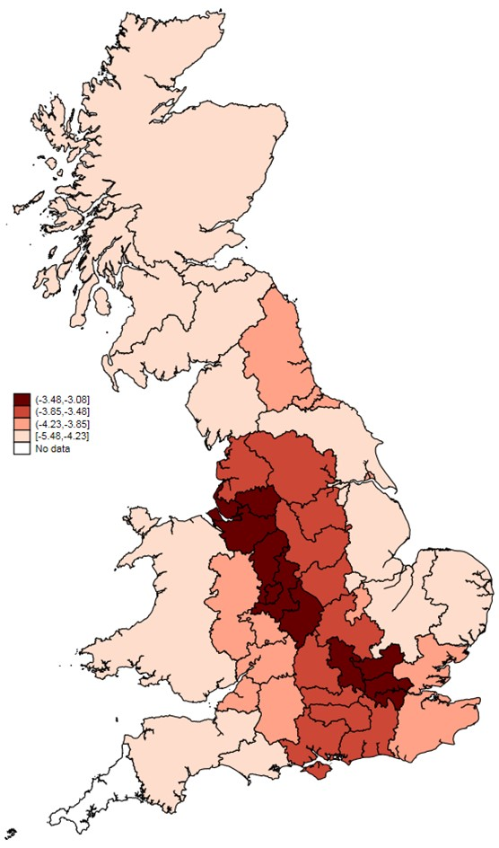
Mean of ln⁡ Distance Index by Local Enterprise Partnership, all AM sectors, 2004-2016
UK Innovation Survey, 1994-2016; 'No data' indicates less than 10 firms

Slide 36
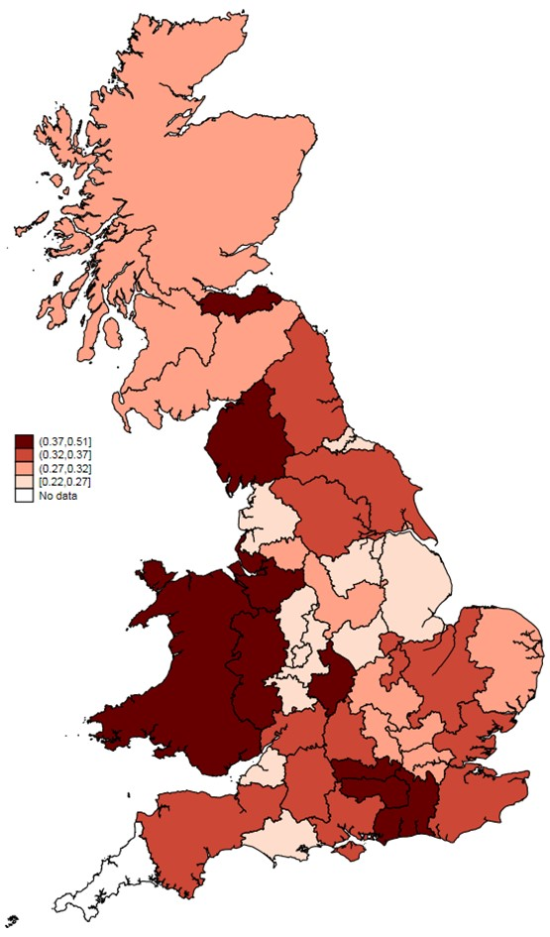
Mean of Absorptive Capacity index by Local Enterprise Partnership, all AM sectors, 2004-2016
UK Innovation Survey, 1994-2016; 'No data' indicates less than 10 firms

Slide 37
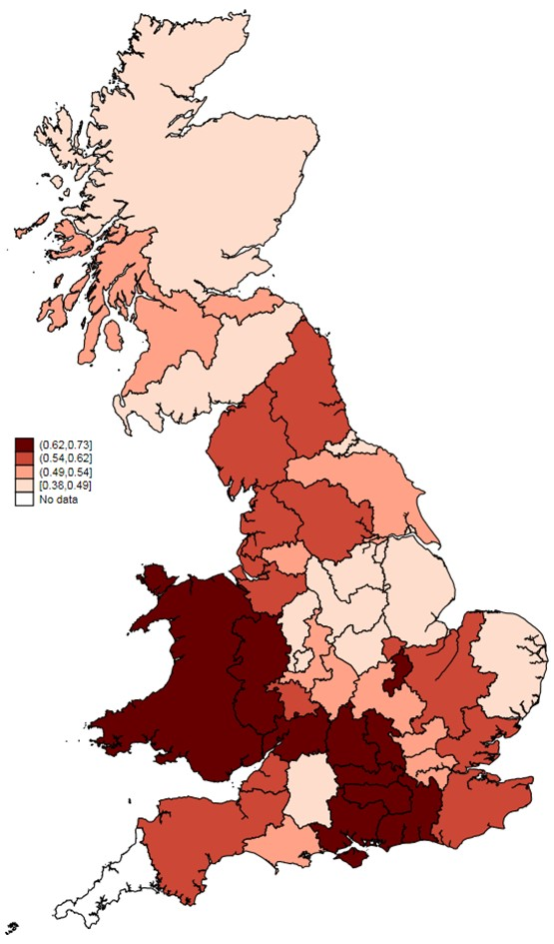
Mean of R&D by Local Enterprise Partnership, all AM sectors, 2004-2016
UK Innovation Survey, 1994-2016; 'No data' indicates less than 10 firms

Slide 38
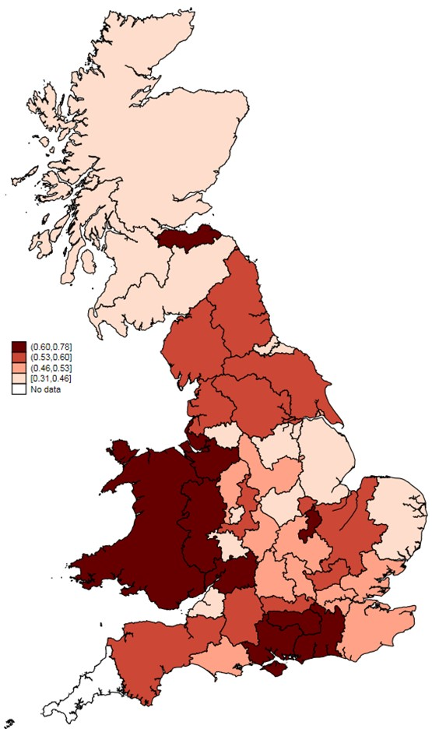
Mean of Innovation by Local Enterprise Partnership, all AM sectors, 2004-2016
UK Innovation Survey, 1994-2016; 'No data' indicates less than 10 firms

Slide 39
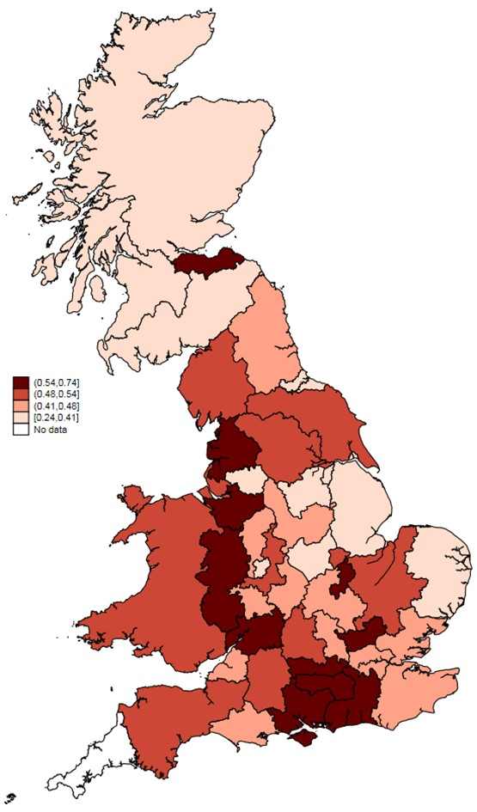
Mean of Product innovation by Local Enterprise Partnership, all AM sectors, 2004-2016
UK Innovation Survey, 1994-2016; 'No data' indicates less than 10 firms

Slide 40
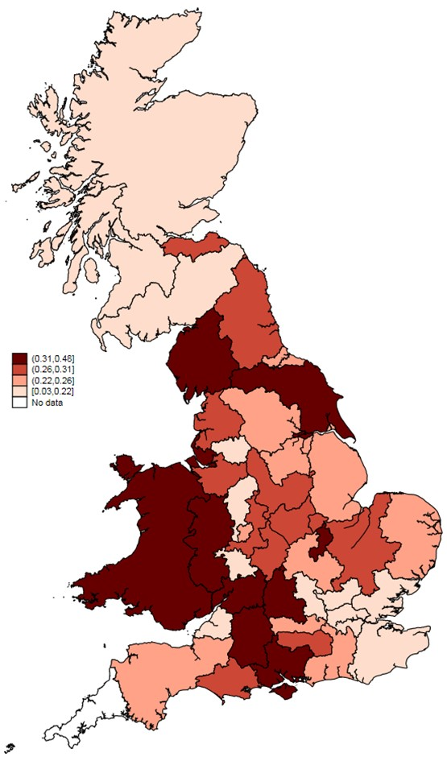
Mean of Process innovation by Local Enterprise Partnership, all AM sectors, 2004-2016
UK Innovation Survey, 1994-2016; 'No data' indicates less than 10 firms

Slide 41
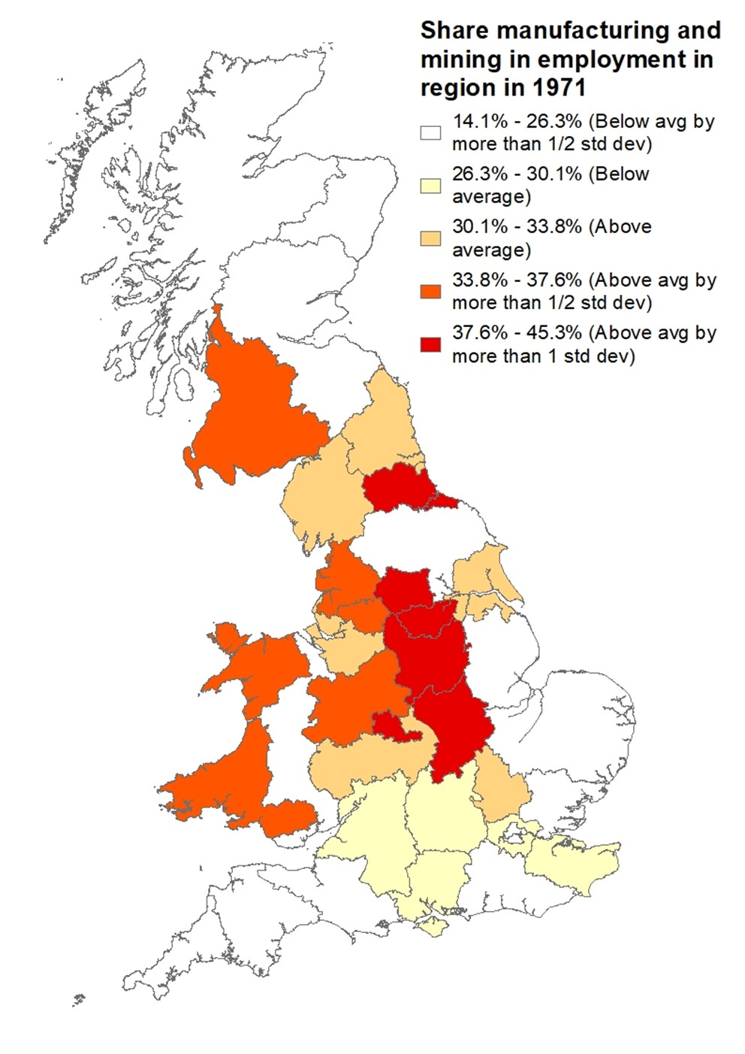
Traditional Industrial Regions: Manufacturing and Mining share of employment in 1971

Slide 42
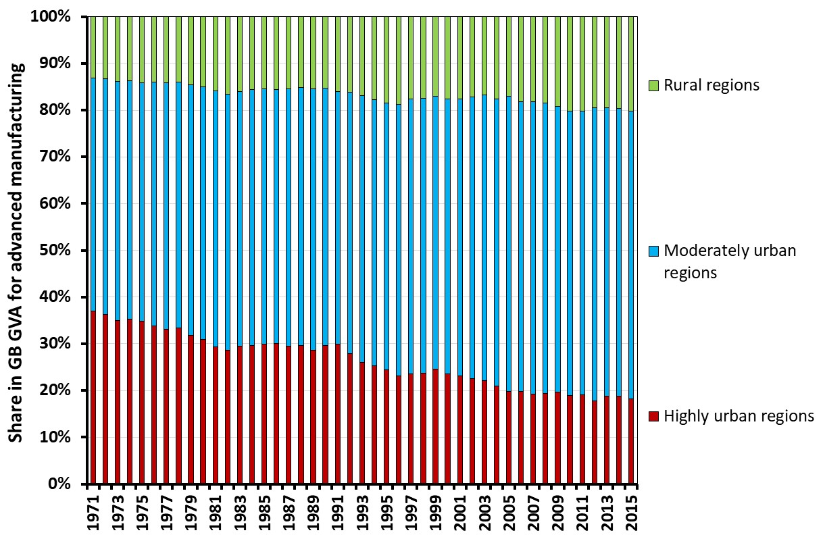
Development of shares by type of region (NUTS 2) in GVA Adv. Manufacturing
Population Density 1971 < 186 pop/km2
Population density 1971 Between 186 and 846 pop/km2
Population density 1971 > 846 pop/km2
Cambridge Econometrics, series at NUTS2-level 1971-2015

Slide 43
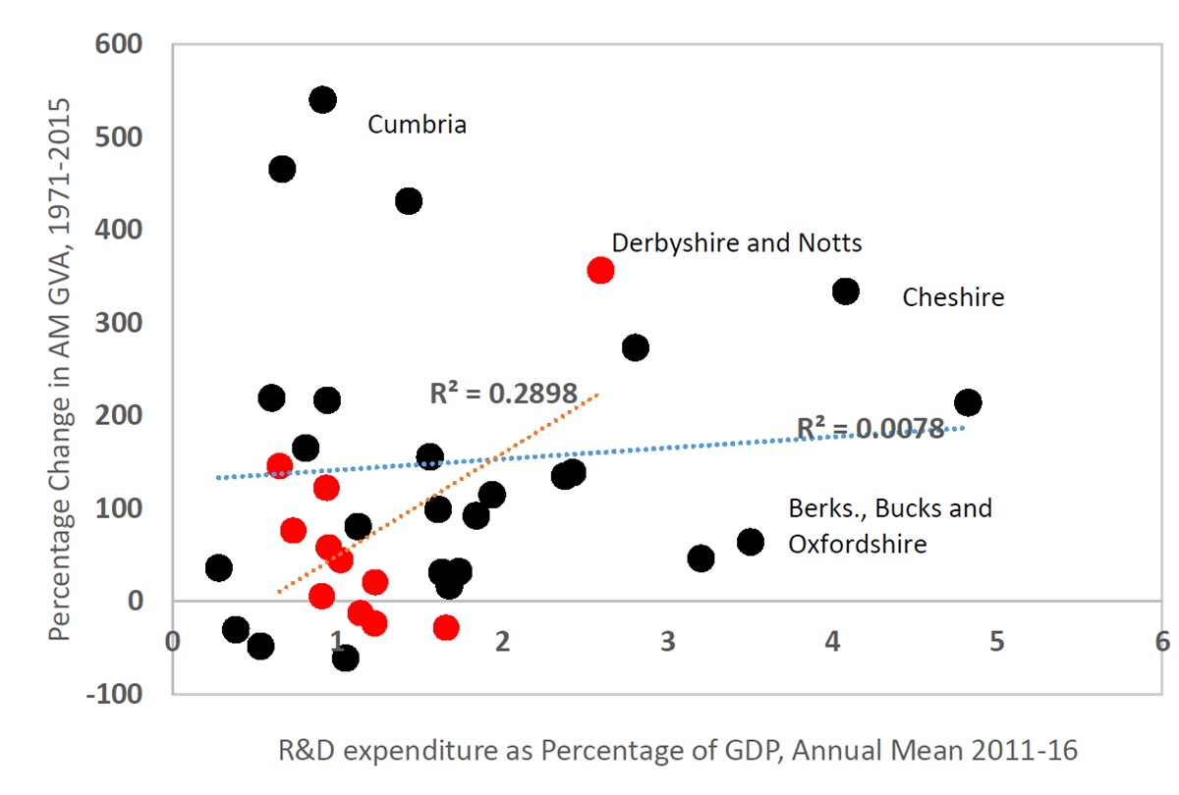
Performance Advanced Manufacturing and R&D expenditure as percentage of GDP

Slide 44
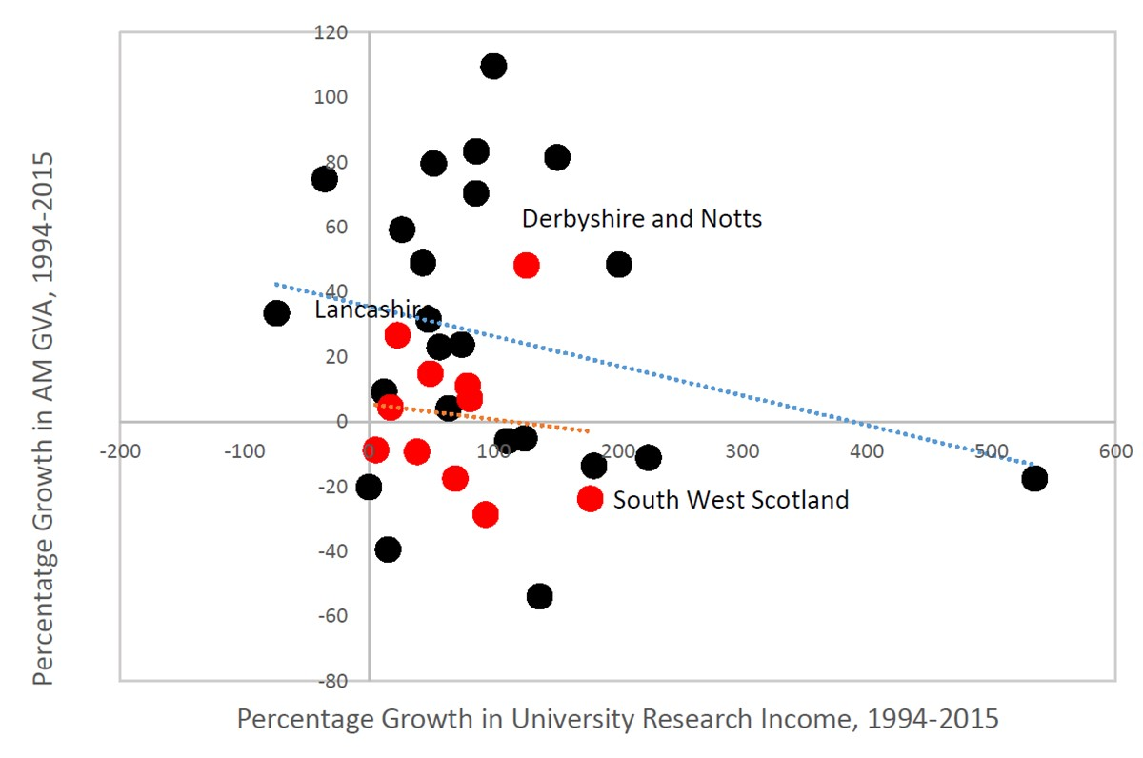
Performance Advanced Manufacturing and Growth University Research Income 1995-2015

